Slide 1


Mahendra Patil
9-Sep-2023

Slide 2

Outline
Executive Summary
Introduction
Methodology
Results
Conclusion
Appendix

Slide 3
Executive Summary
Summary of Methodologies:
Data Collection
Data Wrangling
Exploratory Data Analysis
Interactive Visual Analytics
Predictive Analysis (Classification)
Summary of Results:
Exploratory Data Analysis (EDA) results
Geospatial analytics
Interactive dashboard
Predictive analysis of classification models

Slide 4
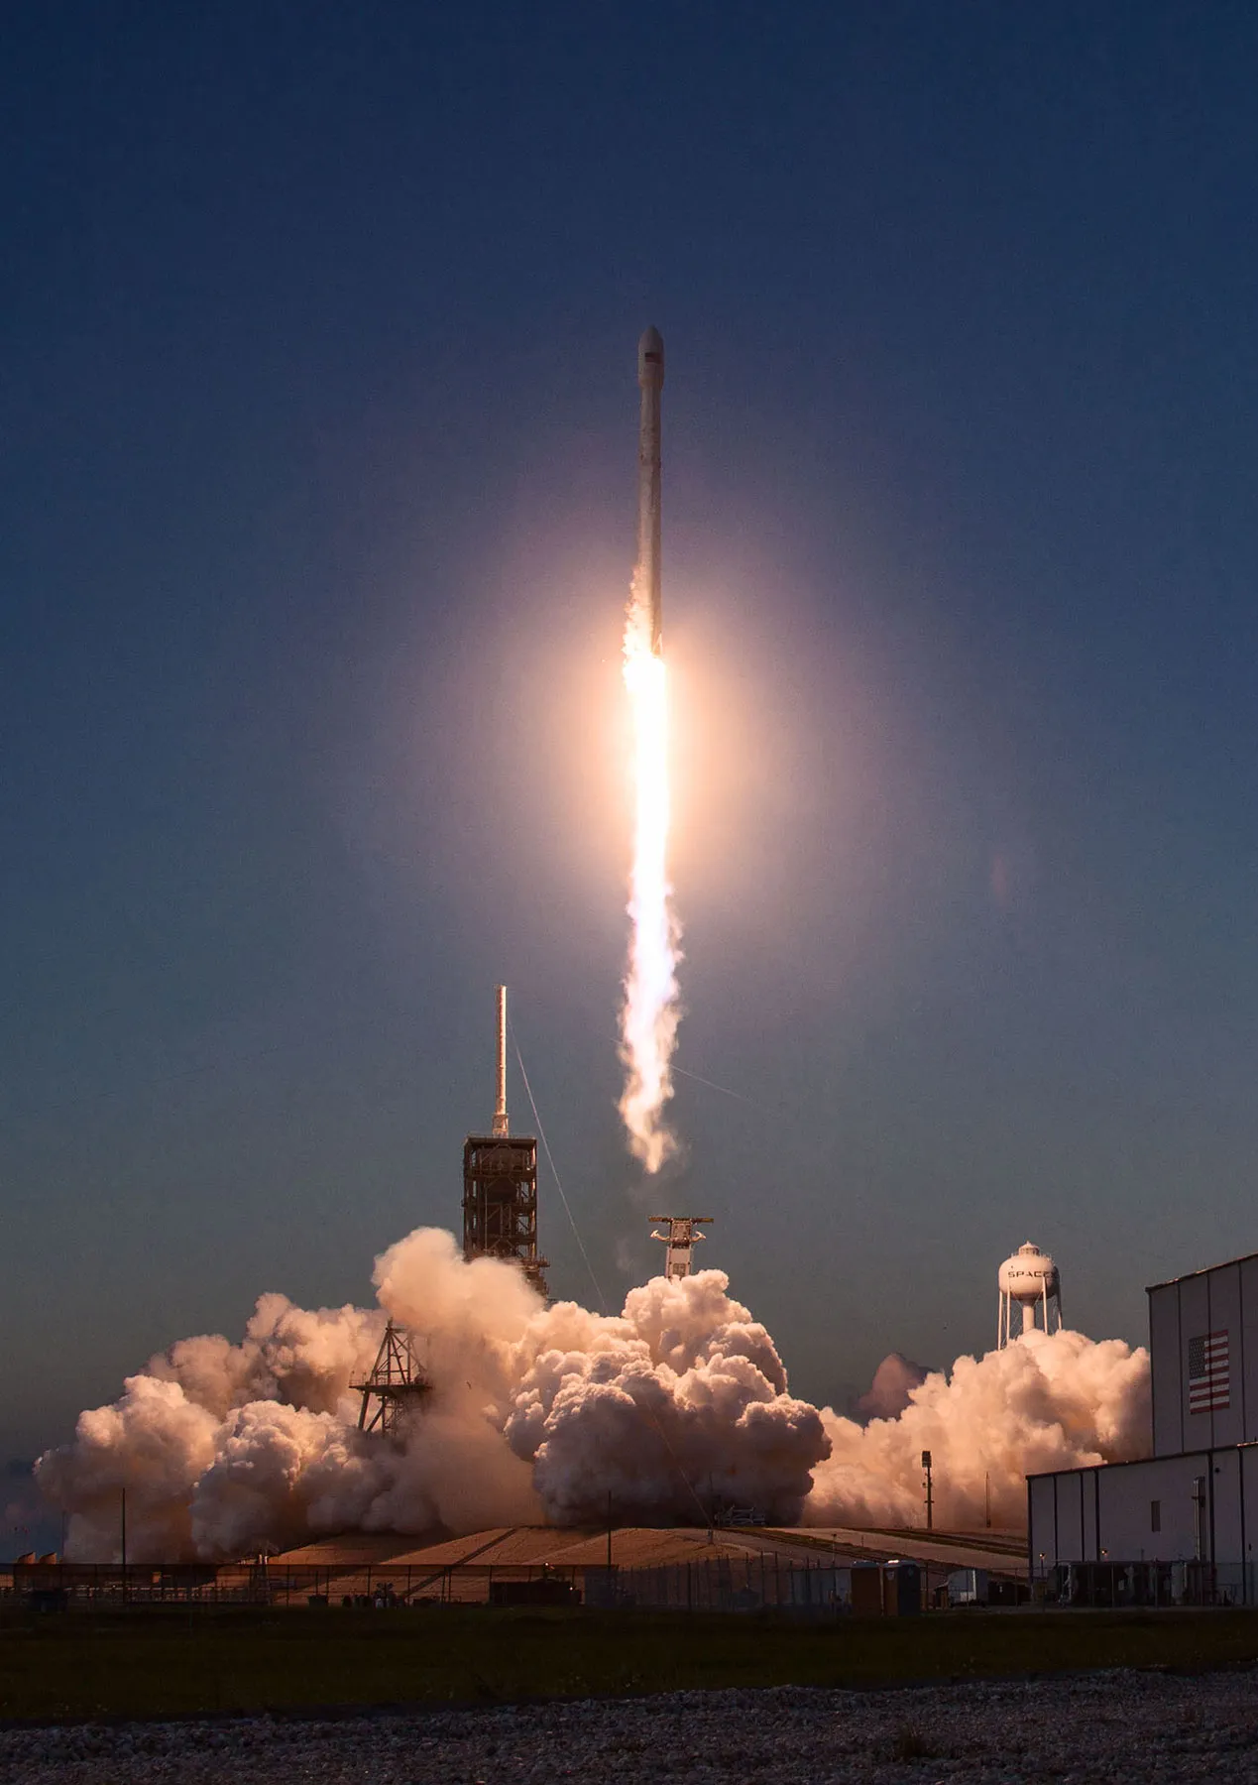
Introduction
SpaceX Falcon 9 rocket launch costs around 62 million dollars compared to others quoting upward of 165 million dollars. SpaceX launch is affordable due to re-use of the first stage. Total cost of launch thus depends on the probability of landing of the first stage. This information can be used if an alternate company wants to bid against SpaceX for a rocket launch.
Problem this project intends to solve is to use various data science methodologies to find out various factors that contribute to outcome of launch and determine the best predicative model to predict the probability of first stage landing successfully.

Slide 5

Section 1

Slide 6
Methodology
Executive Summary
Data collection methodology:
GET request to the SpaceX REST API & Web scrapping on SpaceX Wikipedia (HTML) page
Perform data wrangling
Create a landing outcome label from Outcome column
Perform exploratory data analysis (EDA) using visualization and SQL
Perform interactive visual analytics using Folium and Plotly Dash
Perform predictive analysis using classification models
Use Scikit-Learn to standardize data, split into training and test data set.
Implement Cross Validation using GridSerachCV to find best hyperparameters using training dataset for various classification models - Logistic Regression, SVM, Decision Tree, and KNN.
Use best hyperparameters on these models with test data, evaluate the model performance using accuracy and confusion matrix.

Slide 7
Data Collection – SpaceX API
GET request to SpaceX API
Parse, normalize, load data in dataframe
Clean/process data using custom functions
Construct new dataframe with processed data
Filter dataframe to only include Falcon 9 launches
GitHub URL

Slide 8
Data Collection - Scraping
GET request to Wiki HTML page
Use BeautifulSoup to extract columns from HTML table header
Parse HTML tables to create launch records in dictionary
Use data dictionary to create Pandas dataframe
Export data to CSV file
GitHub URL

Slide 9
Data Wrangling
Load CSV dataset into Pandas data frame
Analyze missing values for all attributes
Calculate the number of launces on each site
Calculate the number and occurrence of each orbit
Calculate the number and occurrence of mission outcome per orbit type
Create a landing outcome label from Outcome column
Export dataset to CSV
GitHub URL

Slide 10
EDA with Data Visualization
Scatter Charts: These are used to visualize the correlation between features / independent variables. Here they were used for Flight Number and Launch Site, Payload and Launch Site, Orbit Type and Flight Number, Payload and Orbit Type
Bar Chart: These are used to compare different categorical and numerical features / variables. Here it was used for Success Rate and Orbit Type
Line Charts: These are used to depict the change in value of feature / variable over time. Here it was used to visualize Success Rate over Years
GitHub URL

Slide 11
EDA with SQL
Summary of performed SQL queries: GitHub URL
Display the names of the unique launch sites in the space mission
Display 5 records where launch sites begin with the string 'CCA’
Display the total payload mass carried by boosters launched by NASA (CRS)
Display average payload mass carried by booster version F9 v1.1
List the date when the first successful landing outcome in ground pad was achieved
List the names of the boosters which have success on drone ship and have payload mass between 4000 and 6000 kgs
List the total number of successful and failed missions
List the names of the booster versions which have carried the maximum payload mass
Listing the failed landing outcomes on drone ships, their booster versions, and launch site names for year 2015
Rank the count of landing outcomes (such as Failure (drone ship) or Success (ground pad)) between the date 2010-06-04 and 2017-03-20, in descending order
GitHub URL

Slide 12
Build an Interactive Map with Folium
Markers of all Launch Sites: Added Marker with Circle, Popup Label and Text Label of NASA Johnson Space Center using its latitude and longitude coordinates as a start location. Added Markers with Circle, Popup Label and Text Label of all Launch Sites using their latitude and longitude coordinates to show their geographical locations and proximity to Equator and coasts.
Coloured Markers of the launch outcomes for each Launch Site: Added coloured Markers of success (Green) and failed (Red) launches using Marker Cluster to identify which launch sites have relatively high success rates.
Distances between a Launch Site to its proximities: Added coloured Lines to show distances between the Launch Site KSC LC-39A (as an example) and its proximities like Railway, Highway, Coastline and Closest City
GitHub URL

Slide 13
Build a Dashboard with Plotly Dash
Pie Chart, Scatter Plot, and Slider are added to dashboard.
If all sites are selected in the dropdown, pie chart depicts distribution of successful launches across all launch sites
If specific site is selected in the dropdown, pie chart depicts distribution of successful vs failed launches for the selected launch site
Scatter plot is used to visualize the relationship between Outcome and Payload mass for various booster versions.
Slider could be used to interactively visualize scatter plot by applying filter on various ranges of Payload mass
GitHub URL

Slide 14
Predictive Analysis (Classification)
Gathered Data (from IBM Cloud storage)
Standardized Data (Standard Scaler transformation)
Split Data into training and testing sets
For each model: Logistic Regression, SVM, Decision Tree, and KNN
Use Cross validation (GridSerach) to find best hyperparameters
Find model performance on test data using best hyperparameters
Use Confusion matrix to evaluate the model
Find the best performing model by comparing the respective accuracies on test data
GitHub URL

Slide 15
Results
Exploratory data analysis results
Interactive analytics demo in screenshots
Predictive analysis results

Slide 16

Section 2

Slide 17
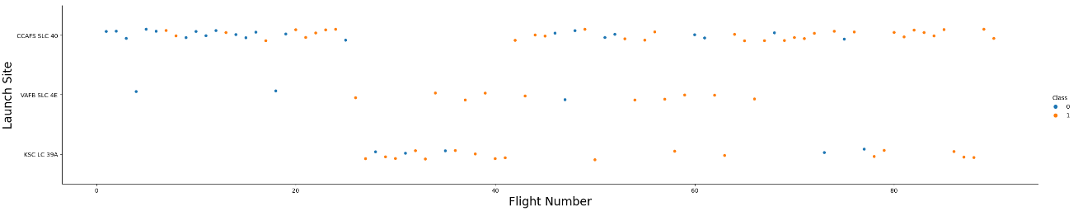
Flight Number vs. Launch Site
Class 0 (blue) represents failure while Class 1 (orange) represents successful launch
Success rate has increased with increase in flight number i.e. recent launches
CCAFS SLC 40 saw most of the early launches with mixed results mostly failing early on.
KSC LC 39A has seen no launches early on (till flight number 25)

Slide 18
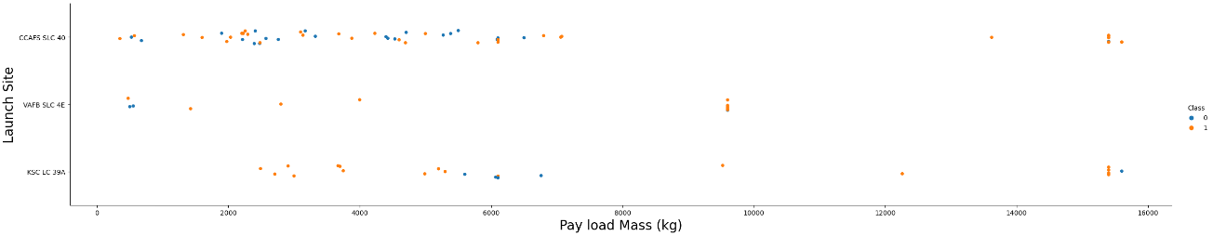
Payload vs. Launch Site
Class 0 (blue) represents failure while Class 1 (orange) represents successful launch
This scatter plot shows that there is no definitive correlation between Payload and Launch site.
Majority of the launches have been with payload smaller than 7000 kgs and greater than 15000 kgs with very few launches in the mid-range.
CCAFS SLC 40 site is mostly used for relatively lighter payloads.

Slide 19
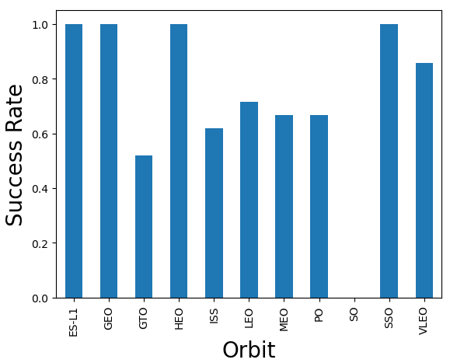
Success Rate vs. Orbit Type
Launches for orbits ES-L1, GEO, HEO, and SSO have been hugely successful (~100% success rate)
SO has the least success rate due to just 1 attempt that ended in failure.
Success rate for GTO is around 50% but also have seen most launches.

Slide 20
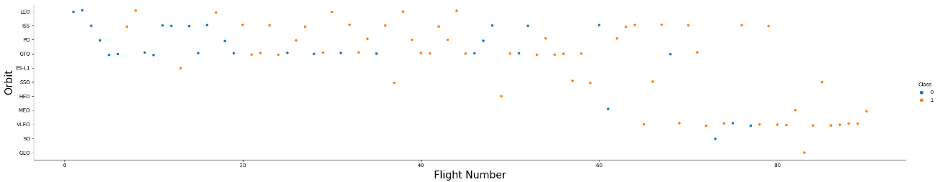
Flight Number vs. Orbit Type
Class 0 (blue) represents failure while Class 1 (orange) represents successful launch
In general success rate has improved with more flights, especially LEO which has seen successful launches after just 2 early failures.
VLFO orbit launches have seen significant success rate recently (larger flight number)

Slide 21
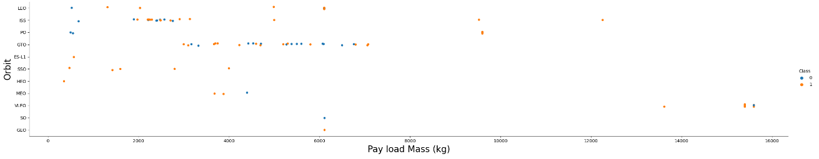
Payload vs. Orbit Type
Class 0 (blue) represents failure while Class 1 (orange) represents successful launch
PO, ISS, and LEO orbits have seen significant success for heavy payloads
VLEO orbit is generally used for heavy payload launches.
SSO orbit launches have been hugely successful for smaller payloads.

Slide 22
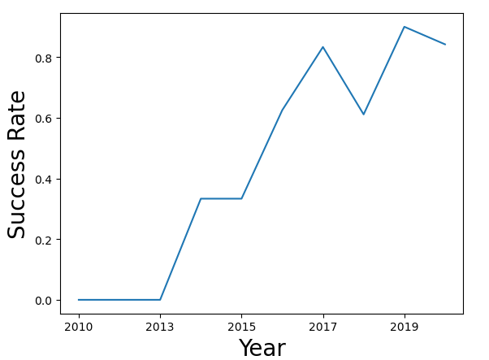
Launch Success Yearly Trend
Launch success rate has been steadily increasing since 2013 barring a deep in 2018 only to be bounced back to higher level after 2019.
Recent success rate is greater than 80%

Slide 23
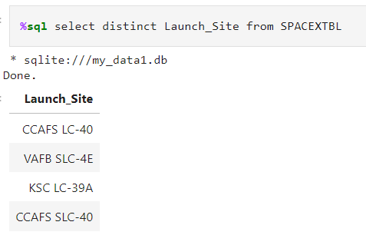
All Launch Site Names
This query displays the list of all 4 launch sites using SELECT and DISTINT function.

Slide 24
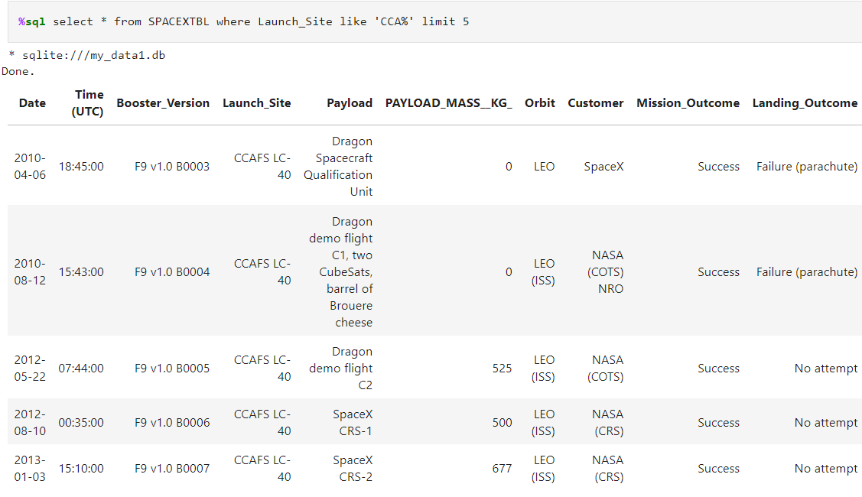
Launch Site Names Begin with 'CCA'
LIKE clause filters the results to include only records starting with CCA
LIMIT clause limits the number of records to 5

Slide 25
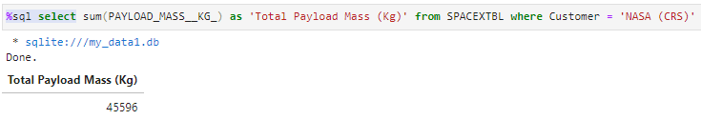
Total Payload Mass
This query sums up the payload carried by boosters from NASA
WHERE clause limits records to customer ‘NASA (CRS)’
SELECT cause along with SUM function displays Total payload mass.

Slide 26
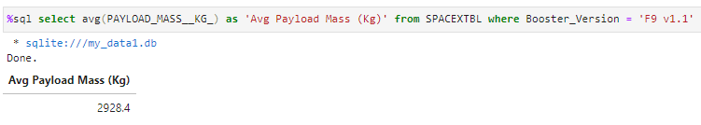
Average Payload Mass by F9 v1.1
AVG function calculates the average payload mass
WHERE clause limits the records to booster version F9 v1.1

Slide 27
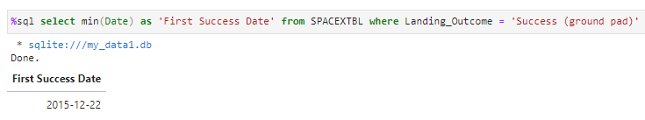
First Successful Ground Landing Date
WHERE clause limits the landing outcome to successful landing on ground pad
MIN function selects the minimum i.e. first landing date

Slide 28
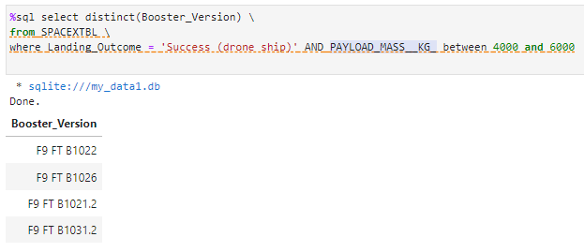
Successful Drone Ship Landing with Payload between 4000 and 6000
DISTINCT function selects unique booster versions to avoid listing duplicates.
WHERE clause limits landing outcome to success on drone ship and payload mass between 4000 and 6000 kgs.

Slide 29
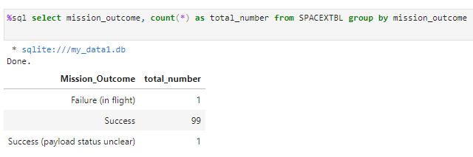
Total Number of Successful and Failure Mission Outcomes
This query uses GROUP BY clause and COUNT function to get total number of successful and failed missions.
Only 1 mission failed i.e 99% of launches fulfilled desired mission outcome

Slide 30
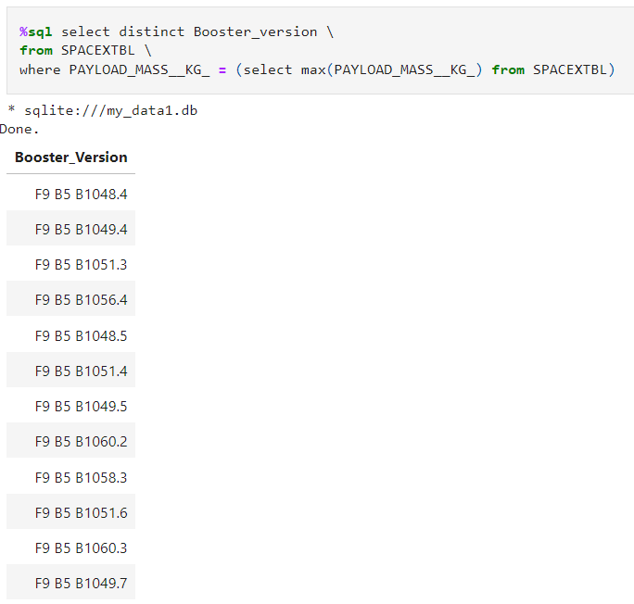
Boosters Carried Maximum Payload
Subquery calculates the maximum payload in kgs first.
Main query uses WHERE clause on the result of subquery and then DISTINCT function to list the required boosters.

Slide 31
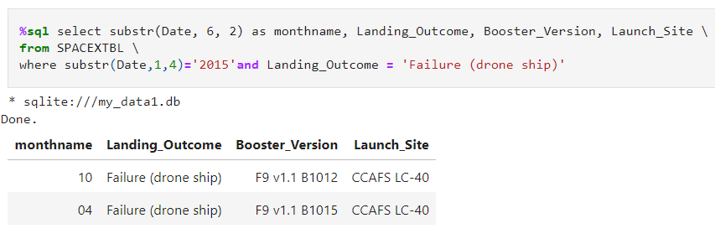
2015 Launch Records
SUBSTR function is used to extract year from Date and compare against 2015
Month April (04) and October (10) saw drone ship landing failure each.

Slide 32
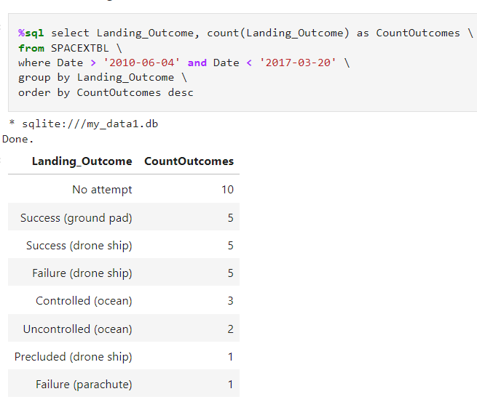
Rank Landing Outcomes Between 2010-06-04 and 2017-03-20
WHERE clause selects records between desired dates.
GROUP BY clause groups the records by Landing_Outcome which are further counted using count function in select clause.
ORDER BY sorts the resulting records in descending order by count of outcomes.

Slide 33

Section 3

Slide 34
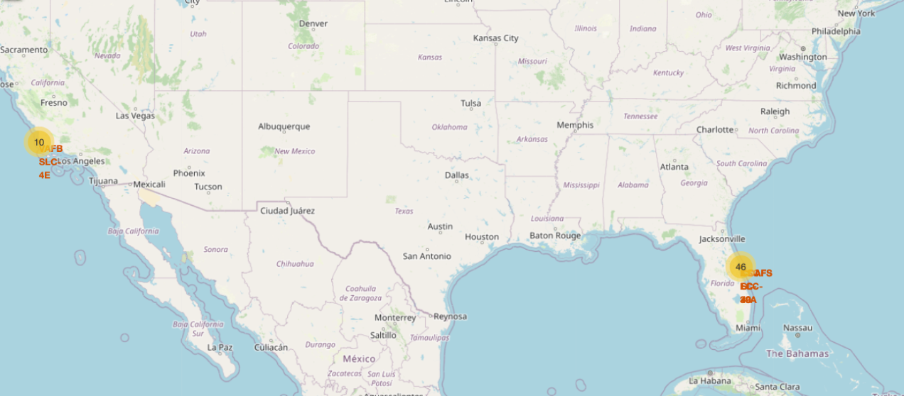
Launch Site Geographical Locations
Map shows the Launch sites along with the number of launches
All launch sites are either on east or west coast and mostly in the southern parts closer to the equator. Proximity to the ocean reduces the risk of debris or failed rocket falling into residential areas.

Slide 35
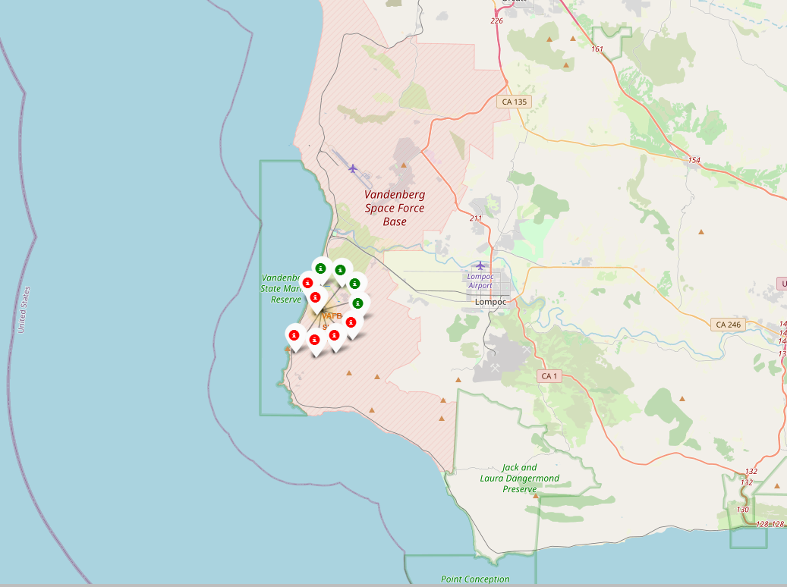
Color coded Successful/Failed Launches
Clusters on the folium are configured to display success / failure status of launces using color codes.
Green icon indicates successful and Red icon indicates failed launch.
This example shows 4 successful and 6 failed launches at VAFB SLC-4E site

Slide 36
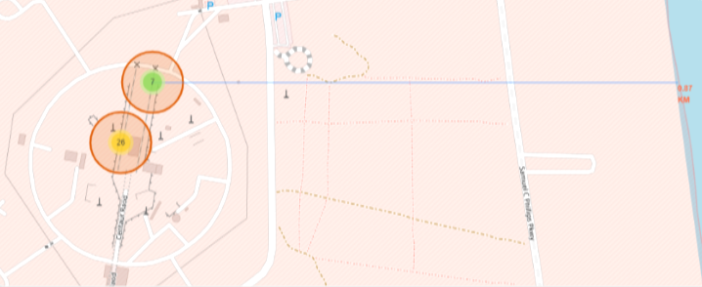
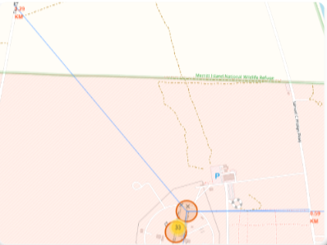
Proximity of Launch Site With Points Of Interest
Launch sites are located closer to railway and highway as Rocket launches involve transportation of heavy material and personnel.
Launch sites are located closer to the coastline to reduces the risk of debris or failed rocket falling into residential areas.

Slide 37

Section 4

Slide 38
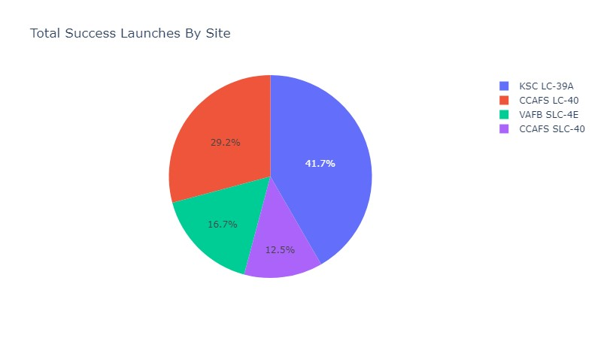
Success Launches By Site
This is an aggregate chart indicating share of each site in successful launches, not to be confused with success rate of individual site.
The launch site “KSC LC-39A” has major (41.7%) share of successful launches followed by CCASFS LC-40, VAFG SLC-4E, CCAFS SLC-40 in that order.

Slide 39
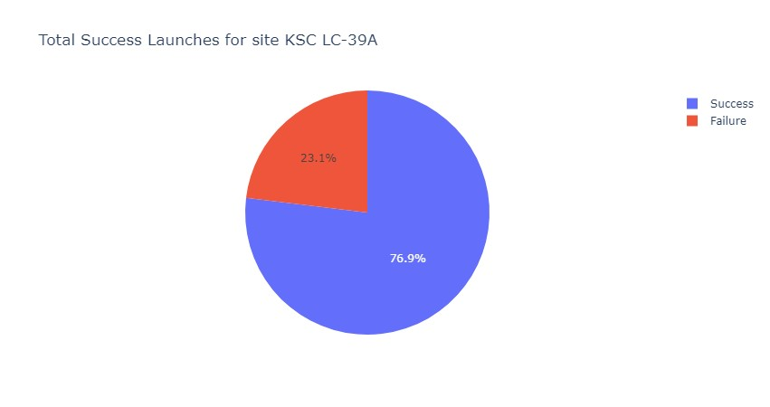
Most Successful Launch Site
This chart shows success / failure percentage for most successful site KSC LC-39A
There is 76.9% chance that mission launched from this site will be successful

Slide 40
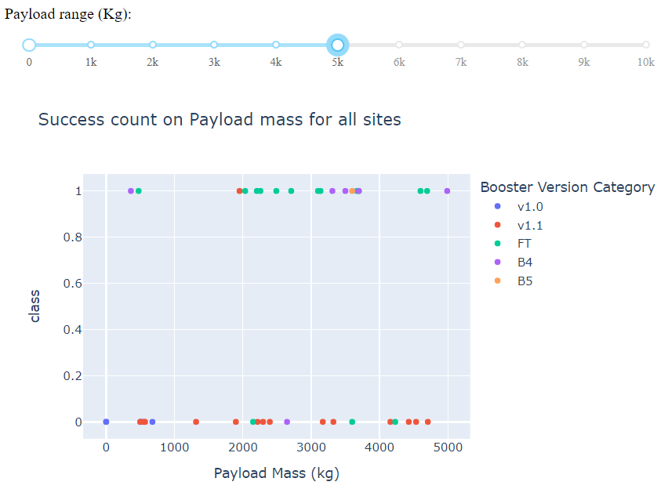
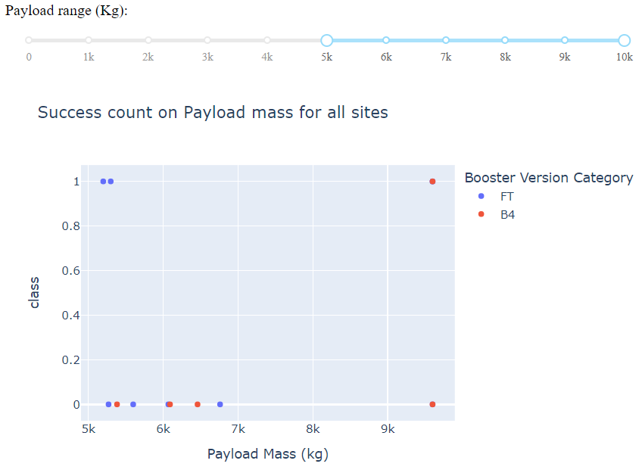
Payload Ranges vs Launch Success Rate
Success rate of Launches for Smaller to medium payloads (< 5000 kgs) is higher than heavy payloads (5000-10000 kgs)
Boost version FT has been one of the most successful boosters.

Slide 41

Section 5

Slide 42
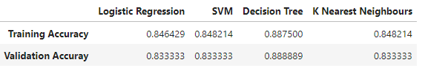
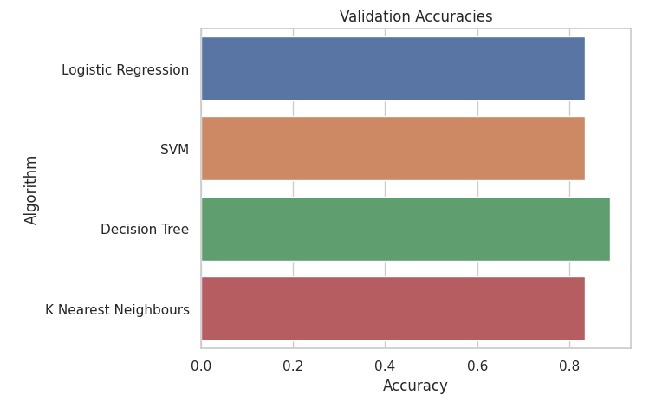
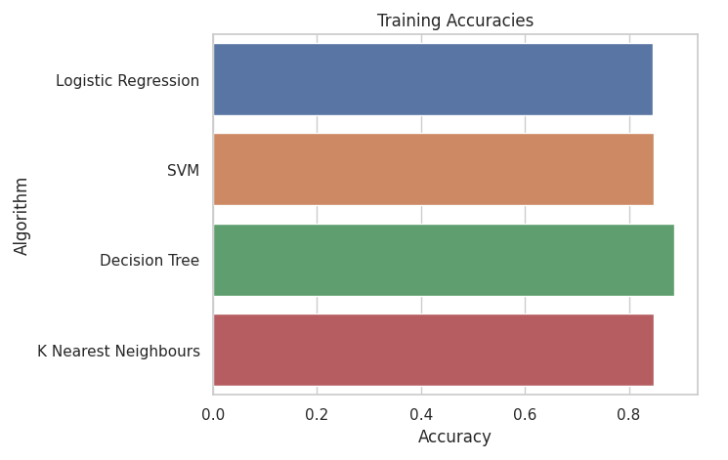
Classification Accuracy
Decision tree model has the highest accuracy for both training and test data

Slide 43

Confusion Matrix
There are no False Negatives, so model has desired sensitivity (Recall) of 1.
There are 3 False positives, so model’s precision is 0.8 which is not perfect but acceptable for limited dataset.

Slide 44
Conclusions
Majority of the launches are with payload smaller than 7000 kgs and greater than 15000 kgs.
Launches for orbits ES-L1, GEO, HEO, and SSO have been hugely successful (~100% success rate).
PO, ISS, and LEO orbits have seen significant success for heavy payloads.
Launch success rate has been improving since 2013 barring a deep in 2018 only to be bounced back to after 2019, Recent success rate is greater than 80%
Only 1 mission failed i.e 99% of launches fulfilled desired mission outcome.
All launch sites are located on coast and mostly in the southern parts closer to the equator. Proximity to the ocean reduces the risk of debris or failed rocket falling into residential areas. Proximity to railway and highway is important factor as Rocket launches involve transportation of heavy material and personnel.
Success rate for smaller to medium payloads (< 5000 kgs) is higher than heavy payloads (5000-10000 kgs).
For outcome prediction, Decision tree model has the highest accuracy for both training and test data.

Slide 45
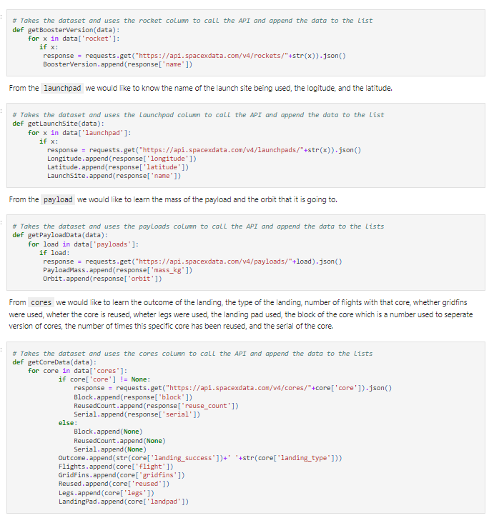
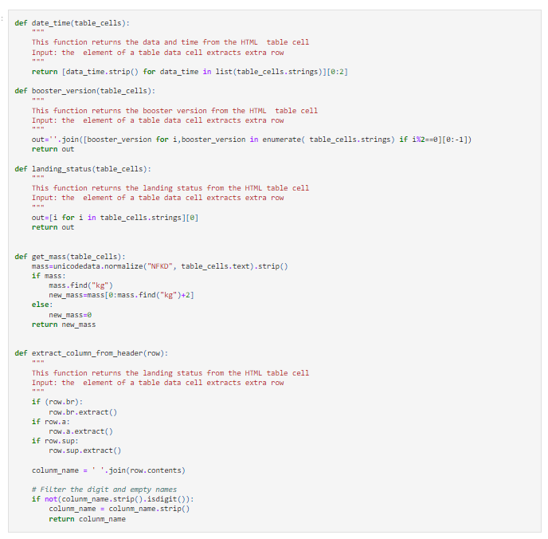
Appendix
Custom Functions
Project GitHub URL

Slide 46


